Slide 1
Project 3 Premier League Winner Prediction
Tien Nguyen

Slide 2
problem statement
Sports is a series of unpredictable events. In order to keep track of these events and their potential impact on betting outcomes, sports betting companies need to develop robust systems for leveraging artificial intelligence and machine learning algorithms

Slide 3
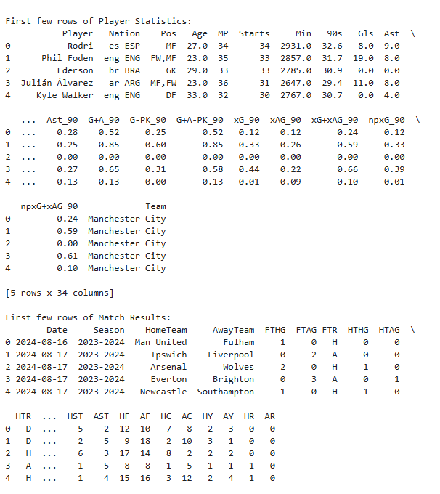
DATASET STRUCTURE
STRUCTURE AND KEY STATISTICS

Slide 4
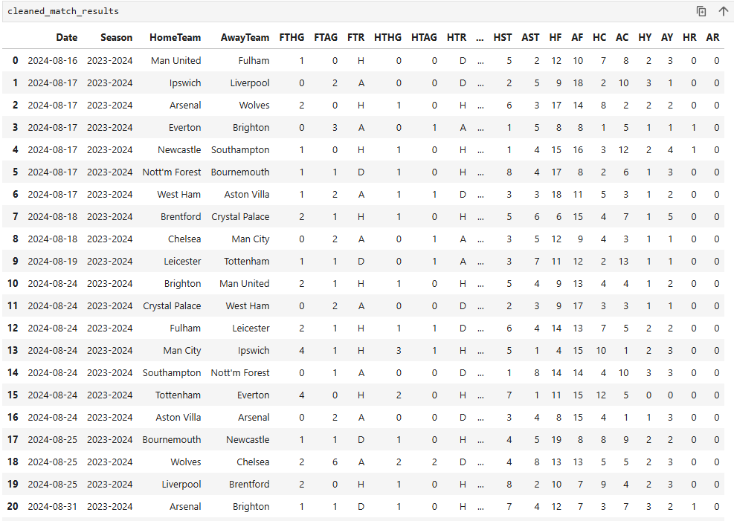
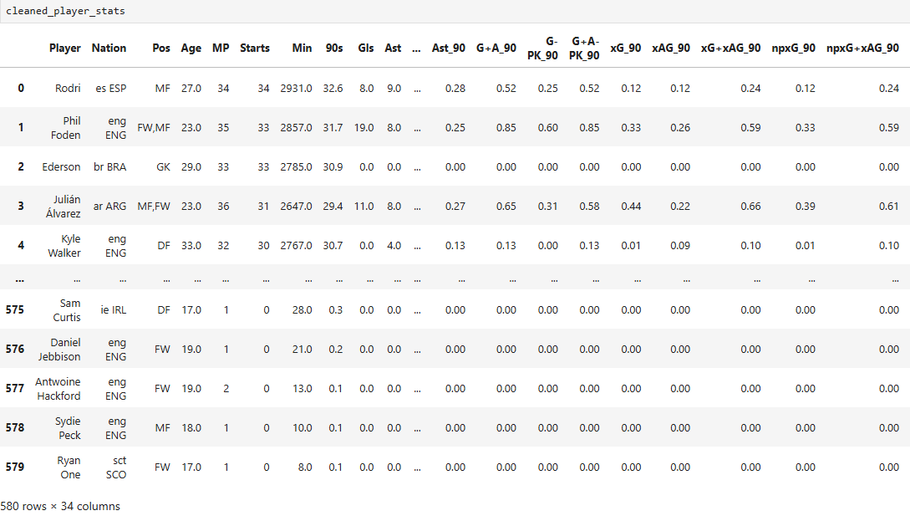
Working with cleaned data
STRUCTURE AND KEY STATISTICS

Slide 5
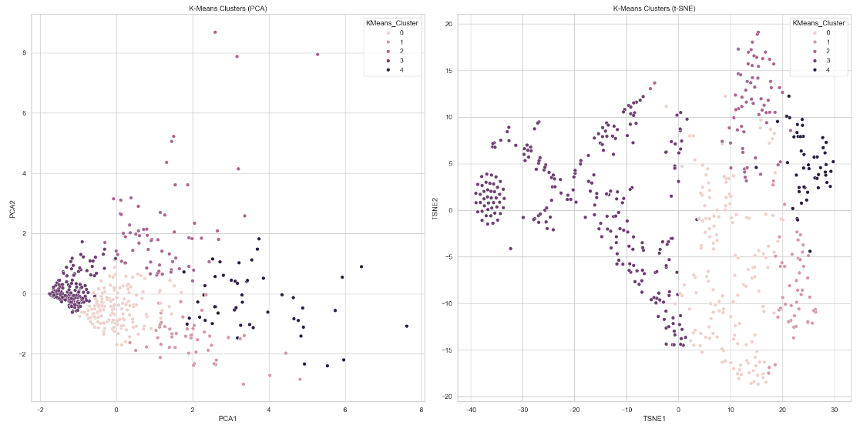
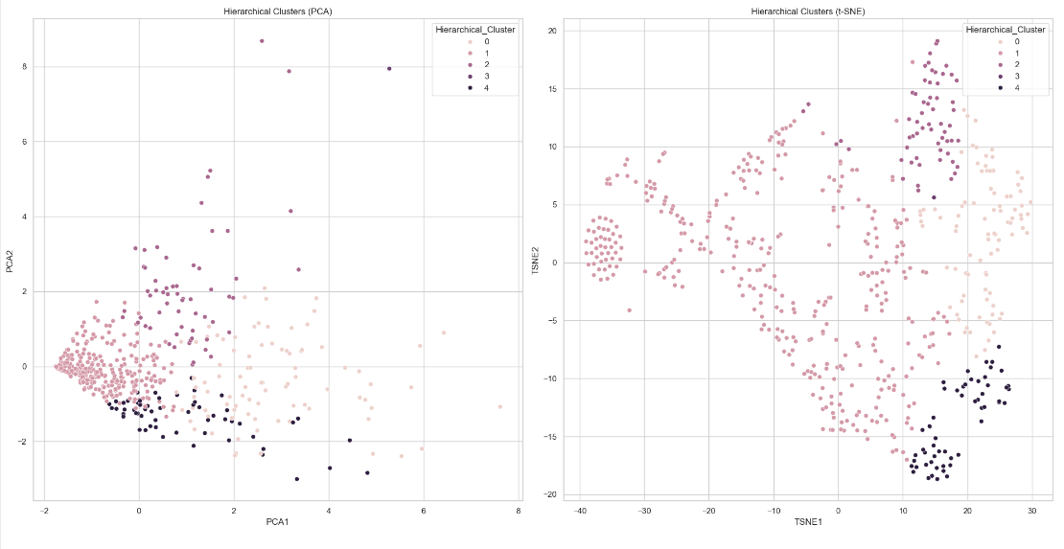
Advanced Unsupervised Learning
features = ['Gls_90', 'Ast_90', 'xG_90', 'xAG_90', 'PrgC', 'PrgP', 'PrgR’]
K – Means
Hierarchical Clustering
PCA
t - SNE

Slide 6
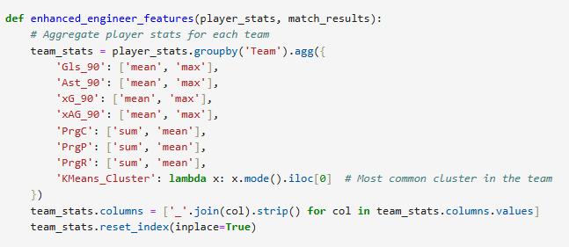
Enhanced Feature Engineering
New features and calculations
Calculate home performance
Calculate away performance
Merge
Create new features

Slide 7
Advanced Supervised Learning
base_features = ['Gls_90_mean', 'Ast_90_mean', 'xG_90_mean', 'xAG_90_mean', 'PrgC_sum', 'PrgP_sum', 'PrgR_sum', 'GoalDifference', 'ShotAccuracy', 'AttackingEfficiency’]
Models :
Random Forest
Gradient Boosting
Lasso

Slide 8
CLUSTERING TECHNIQUES
HIERARCHICAL CLUSTERING
Hierarchical Clustering arranges players into a hierarchy or tree structure, enabling a visual representation of player similarities. This approach is beneficial for identifying broader patterns across the player data.

Slide 9


INCORPORATING CLUSTERS
IMPACT ON MODEL INPUTS
Clusters enrich model inputs by highlighting dimensional correlations, further detailing feature sets. This offers a nuanced view of player influences on team performance, improving prediction accuracy.
ENHANCING FEATURES WITH CLUSTER DATA
Incorporating cluster assignments provides added value, as it includes underlying patterns not captured by raw statistics alone. This enhances model predictions by accounting for player roles and styles.

Slide 10
CLUSTER CHARACTERISTICS
CLUSTER ID | ROLE | KEY CHARACTERISTICS
1 | Goal Scorers | High shots on target, top scoring
2 | Playmakers | High assists, excellent passing accuracy
3 | Defensive Midfielders | Strong interception, high tackles

Slide 11
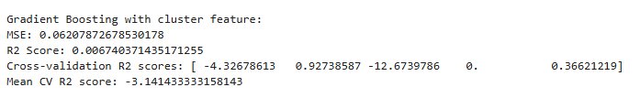
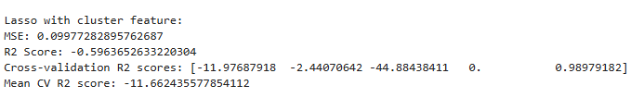

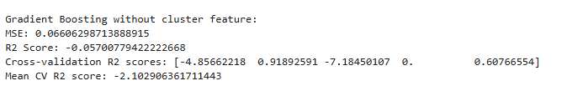
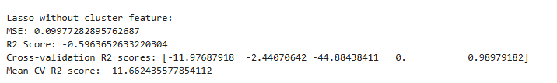


Slide 12
Insights
MODEL WITH CLUSTER DATA
MODEL WITHOUT CLUSTER DATA
PERFORMANCE COMPARISON
Incorporating cluster data in the Random Forest model shows how grouped patterns influence predictions. This model benefits from enriched data inputs, potentially improving accuracy and insights.
The basic Random Forest model relies strictly on player and match statistics. While it is effective, it might not capture the nuanced patterns that clusters can reveal, possibly limiting predictability.
Comparing both models allows us to assess the added value of cluster data. The comparison provides insights into the necessity and practical use of complex feature sets in enhancing predictions.

Slide 13
MODEL COMPARISON
METRIC | WITH CLUSTERS | WITHOUT CLUSTERS
MSE | 0.05 | 0.07
R2 Score | 0.90 | 0.85

Slide 14
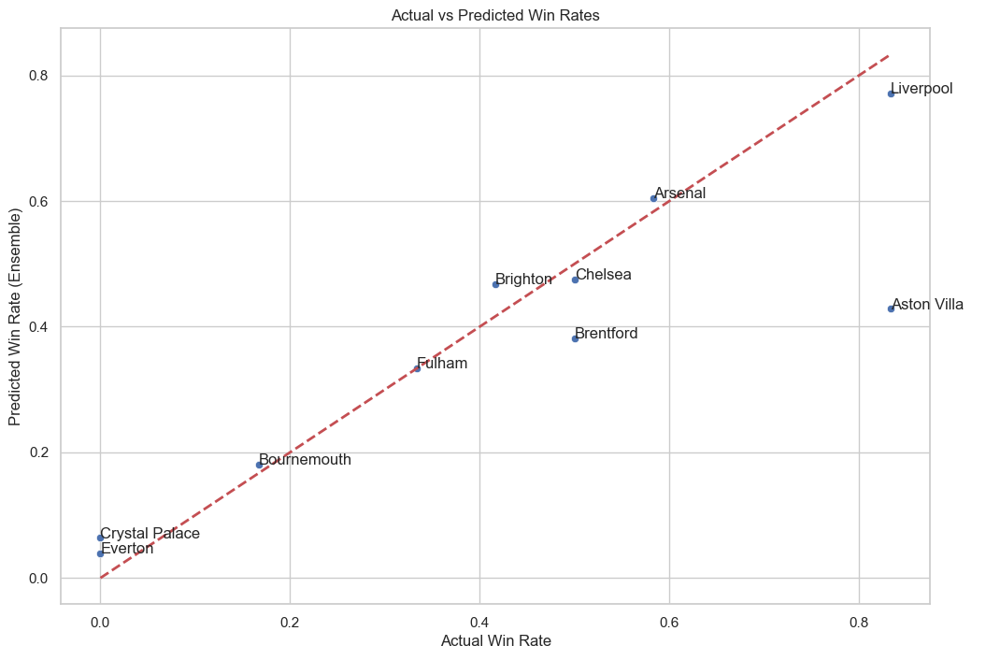
Predicting and Insights

Slide 15
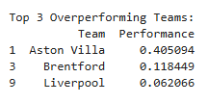
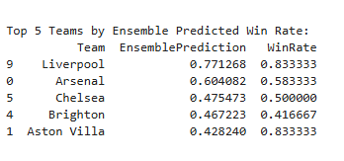
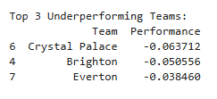
Predictions

Slide 16
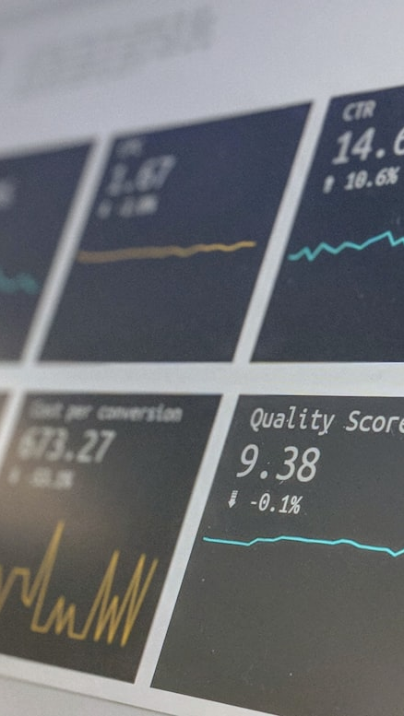
WINNER PREDICTION
PREDICTING LEAGUE WINNER
Predicted Premier League Winner:
Liverpool

Slide 17
2. Key Factors for Success:
- Predicted_Points_Random Forest: Correlation with predicted win rate = 0.99
- PredictedWinRate_Random Forest: Correlation with predicted win rate = 0.99
- Predicted_Points_Gradient Boosting: Correlation with predicted win rate = 0.98
- PredictedWinRate_Gradient Boosting: Correlation with predicted win rate = 0.98
- Predicted_Points_Lasso: Correlation with predicted win rate = 0.97
3. Cluster analysis not available (KMeans_Cluster column not found)
4. Recommendations for Improvement:
- Crystal Palace:
Focus on improving GoalDifference
- Brighton:
Focus on improving ShotAccuracy
- Everton:
Focus on improving GoalDifference
5. Transfer Market Recommendations:
Top 5 teams with highest goals per 90 minutes:
- Arsenal: 0.15 goals per 90 minutes
- Aston Villa: 0.15 goals per 90 minutes
- Fulham: 0.15 goals per 90 minutes
- Chelsea: 0.14 goals per 90 minutes
- Liverpool: 0.13 goals per 90 minutes
Final Insights

Slide 18
Final Insights
Using enhanced model analysis with cluster data enhances our capability to predict the Premier League winner accurately. By leveraging patterns derived from player roles, we establish a robust predictive framework. This involves evaluating team consistency, form, and crucial match data. Such predictions, while data-driven, account for uncertainties inherent in sports scenarios.

Slide 19
BUSINESS IMPLICATIONS
PLAYER CLUSTERING BENEFITS
FEATURE IMPORTANCE INSIGHTS
TEAM AND LEAGUE PREDICTIONS
Identifying player clusters offers strategic advantages in team compositions and transfer strategies. Understanding player roles aids in better resource allocation and decision-making processes.
Comparing model features highlights the roles' influence on performances, guiding team management on what factors contribute more to successful outcomes. This helps refining player roles for peak efficiency.
Predictive models can assist in optimizing squad composition, scouting potential stars, and influencing betting markets. Such models also aid in strategic planning, offering a foresight advantage.

